Slide 1
Aliphatic amines
B.Sc 2nd Year(General)
Anik Sinha
Department of Chemistry
S.B.S.Goverment College, Hili

Slide 2
Overview
Introduction
Classifications of amines
Synthesis of aliphatic amines
Heinsberg’s method of amine separation
Grabriel Phthalimide Synthesis
Distinction of 1⁰, 2⁰, 3⁰ amines
Basicity of amines
Reference

Slide 3
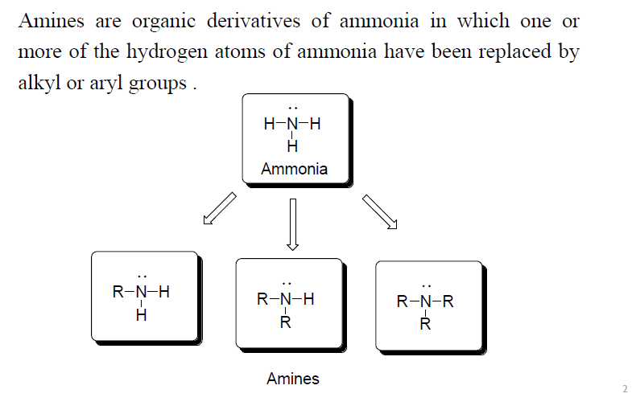
Introduction

Slide 4
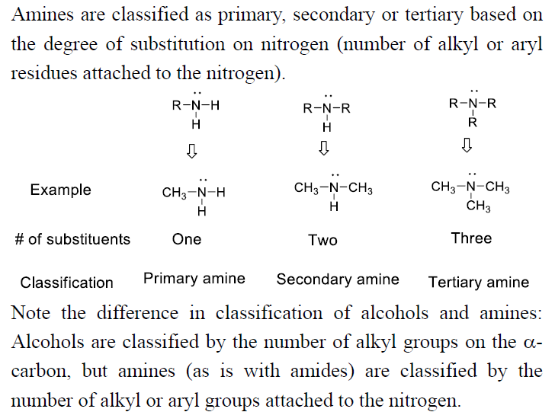
Classification Of Amines

Slide 5
Synthesis of aliphatic amines
Synthesis of Primary amines:
1. Reduction of Nitro compounds:
R=Aliphatic group
Aliphatic Nitro
Compound
Aliphatic Amine
2.Reduction of alkyl cyanide:
H₂/Ni
Or LiAlH₄
R=Aliphatic group
R-CN R-CH₂-NH₂
Aliphatic Cyanide
Or Na/C₂H₅OH
Aliphatic Amine
3. Reduction Of acid amide:
Na/C₂H₅OH Or LiAlH₄
R=Aliphatic group
RCONH₂ RCH₂NH₂
Acid Amide
Aliphatic Amine

Slide 6
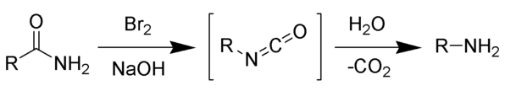
4.Reduction of aldoxime or ketoxime:
Na+C₂H₅OH
LiAlH₄
Aldoxime
Aliphatic Amine
R=Aliphatic group
Na+C₂H₅OH
LiAlH₄
Ketoxime
Aliphatic Amine
5.Hofmann degradation:
The Hofmann rearrangement is the organic reaction of a primary amide to a primary amine with one fewer carbon atom.
Primary
Amine
Primary amide
Isocyanate

Slide 7
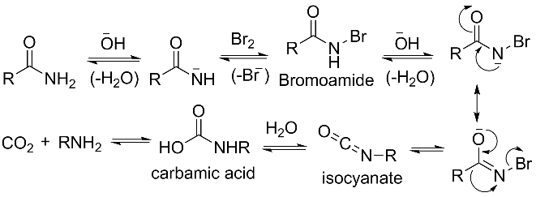
Mechanism
Aromatic amines also participates in Hofmann Degradation.
6.Curtius reaction:
The Curtius rearrangement (or Curtius reaction or Curtius degradation), first defined by Theodo Curtius in 1885, is the thermal decomposition of an acyl azide to an isocyanate with loss of nitrogen gas. The isocyanate then undergoes attack by a variety of nucleophiles such as water, alcohols and amines, to yield a primary amine, carbamate or urea derivative respectively.

Slide 8
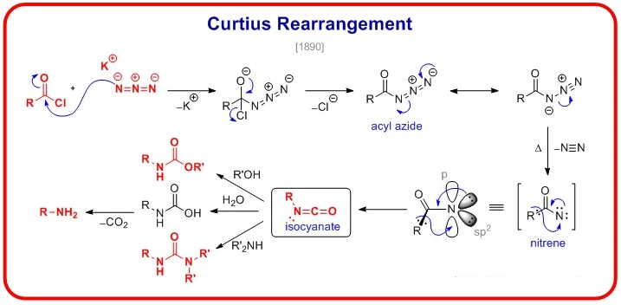
7.Schmidt reaction:
The Schmidt reaction is an organic reaction in which an azide reacts with a carbonyl derivative, usually a aldehyde, ketone, or carboxylic acid, under acidic conditions to give an amine or amide, with expulsion of nitrogen. It is named after Karl Friedrich Schmidt (1887–1971), who first reported it in 1924 by successfully converting benzophenone and hydrazoic acid to benzanilide. Surprisingly, the intramolecular reaction was not reported until 1991 but has become important in the synthesis of natural products.

Slide 9
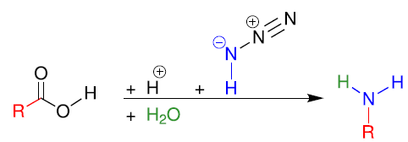
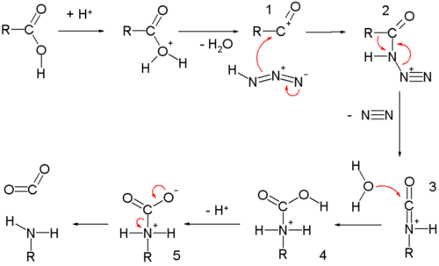
Reaction Scheme:
Mechanism:

Slide 10
Synthesis Of Secondary amine
1. From alkyl isocyanides:
H₂/Ni
Or Na/C₂H₅OH
2. From primary amines:
Δ
C₂H₅NH₂+C₂H₅I (C₂H₅)₂NH+HI
Synthesis Of tertiary amine
1. From quaternary ammonium Hydroxide:
Δ
(CH₃)₄N⁺OH⁻ (CH₃)₃N + CH₃OH
(CH₃CH₂)₄N⁺OH⁻ (CH₃CH₂)₃N+ +H₂O

Slide 11
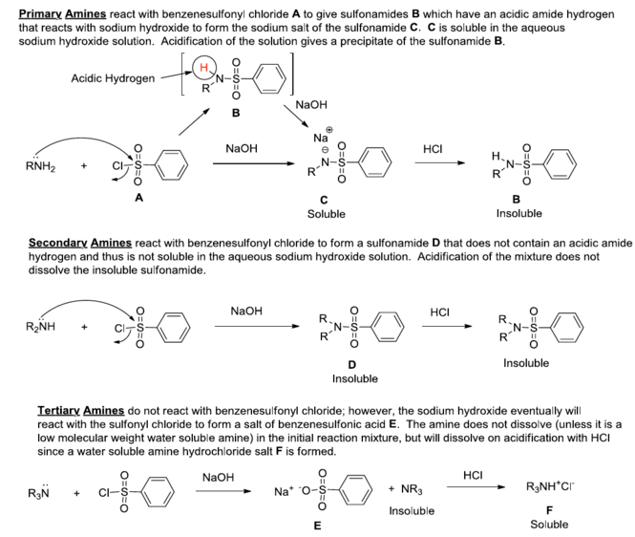
Heinsberg’s method of amine separation

Slide 12
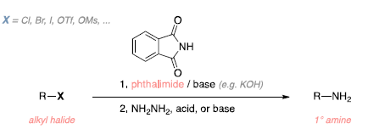
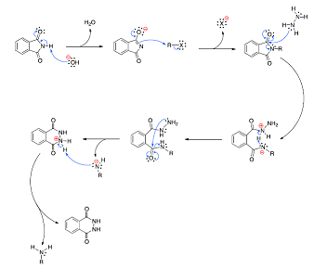
Grabriel Phthalimide Synthesis
The Gabriel synthesis is a chemical reaction that transforms primary alkyl halides into primary amines. Traditionally, the reaction uses potassium phthalimide. The reaction is named after the German chemist Siegmund Gabriel.
Reaction Scheme
Mechanism

Slide 13
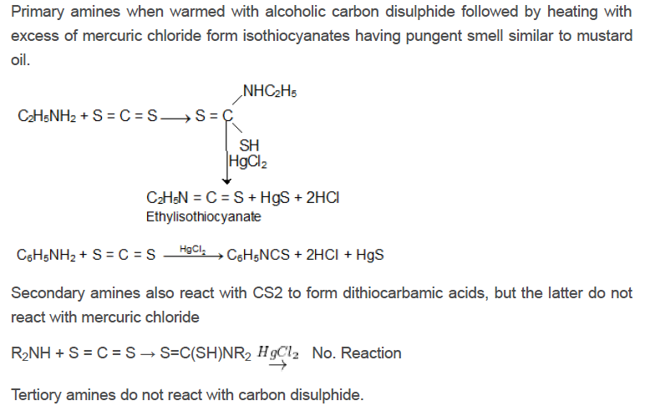
Distinction of 1⁰, 2⁰, 3⁰ amines
1. Heinsberg’s Test:
See previous Sections
2.Hofmann Mustard oil reaction:

Slide 14
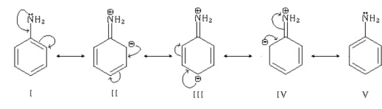
Q. Methyl amine is more basic compare to aniline-Explain.
Methyl amine is more base comparing with aniline, Because:
In case of Aniline, the lone pair of Nitrogen atom participates in the delocalization with benzene ring. Thus the electron density in Nitrogen becomes less. That's why Nitrogen does not donate it electron pair to proton and aniline act as a less base.
But in case of methyl amine(CH₃NH₂) the resonance is not possible and the -CH₃ group has a +I effect, which increase the electron dentistry in Nitrogen. As a result Nitrogen donate it electron pair to proton..That's why Methyl amine react as a strong base compare to aniline.
CH₃ NH₂
+I Effect of -CH₃

Slide 15
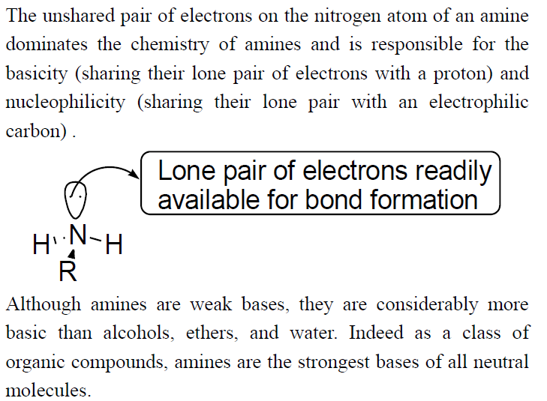
Basicity Of amines

Slide 16
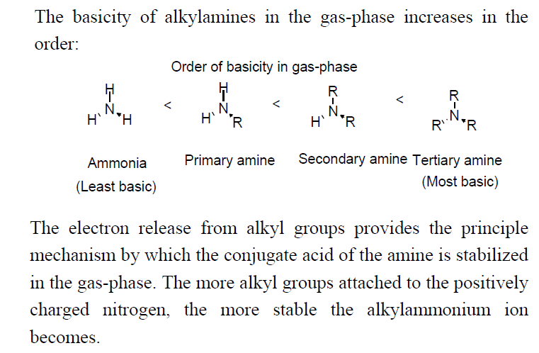
Q. Compare the basicity of primary, secondary and tertiary amines.
In Gas Phase:

Slide 17
In aqueous phase:
(a)Inductive effect:
As the number of alkyl group attaching to nitrogen atom increases the electron density on the nitrogen atom increases so the basicity increases from primary to tertiary. So, considering inductive effect the order should be
(CH ₃)₃N> (CH ₃)₂NH > CH₃NH₂> NH₃
(b) Solvation of Ions:
When amines are dissolved in water, they form protonated amines. As we move from tertiary to primary number of H-bonding of protonated amines increases and also hydration energy increases. The more the hydration energy of the molecule, more is the stability of the amine.
RNH₂ +H₂O → RNH₃ ⁺ + OH⁻ (3 H-Bond)
R₂NH +H₂O → R₂NH₂⁺ + OH⁻ (2 H-Bond)
R₃N + H₂O → R₂NH⁺ + OH⁻ (1-H bond)
According to hydration energy the order should be
NH₃ > CH₃NH₂ > (CH ₃)₂NH > (CH ₃)₃N
Combining these two effects we found that order of basicity in aqueous medium is:
(CH ₃)₂NH > CH₃NH₂ > (CH ₃)₃N > NH₃
pK_{a} 10.77 10.64 9.80 9.25

Slide 18
Reference
1.Organic Chemistry by I.L.Finar
2.Organic Chemistry by Morrison and Boyd.
3.Advance organic chemistry by bahl & bahl.
4.Organic Chemistry by Brucee.
5.Organic chemistry by R.L.Madan
6.A guidebook to Mechanism in Organic chmeistry by P.Sykes
7.Wikipidea

Slide 19
Thank You

